Slide 1


Presented by: Hong
Date: 15/3/2023

Slide 2

Outline
Executive Summary
Introduction
Methodology
Results
Conclusion
Appendix

Slide 3
Executive Summary
Summary of methodologies
Summary of all results

Slide 4
Introduction
My personal background:
Experienced Data Scientist at Space X
Assigned to perform analysis on rocket characteristics.
SPACE Y
Founded by Alien Mask
Competent against SPACE X
Intention: Outperform their rival by undermining the cost of launching a rocket in the first stage.
This presentation will be covered the relationship between a variety of related variable and the target which is the success rate of launching a rocket.

Slide 5

Section 1

Slide 6
Methodology
Executive Summary
Data collection methodology:
Collected by requesting and parsing SpaceX launch data through Space X API and HTTP using Request library.
Perform data wrangling
Removing unnecessary column, convert descriptive text into binary and fill empty cells.
Perform exploratory data analysis (EDA) using visualization and SQL
Perform interactive visual analytics using Folium and Plotly Dash
Perform predictive analysis using classification models
Applying a few machine learning models tested with diverse range of parameter using GridSearch to obtain the highest prediction score.

Slide 7
Data Collection
SpaceX’s launching data is an open source on the web.
1. With the aid of Request.get and BeautifulSoup, we were able to request the required information which is a collection of tables from SpaceX database and WIkipedia through HTTP as well as SpaceX API.
2. Some data were originally classified as a Json file.
3. Decoded with corresponding python function.
4. Utilizing pandas to arrange the data into human readable content.

Slide 8
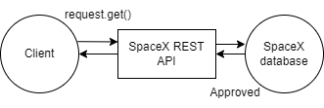
Data Collection – SpaceX API
We as a client to the web send information request.
Once it’s approved, the data requested will be transferred via API.
Link for reference:
Module 1

Slide 9
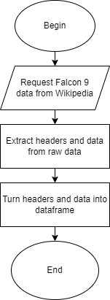
Data Collection - Scraping
Request.get() – request falcon data
BeautifulSoup() – Parse and extract headers and data
Pd.Dataframe() – Form a table filled with column names and information.
Link for reference:
Module 2

Slide 10
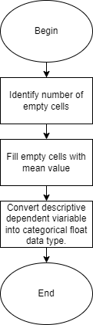
Data Wrangling
Raw material collected consists of blank in certain cells due to unforeseen circumference.
Dataframe provides us with the ability to process the data with mean numbers.
The conversion of categorical target variable from text ease the analysis of data.
Link for reference:
Module 3

Slide 11
EDA with Data Visualization
There are few plot implemented for visualize purposes:
Categorial plot
Regression plot
Bar plot
Linegraph
Link for reference:
IBM-Final-Project-SpaceY/IBM MODULE 5.ipynb at main · keemstarr123/IBM-Final-Project-SpaceY (github.com)

Slide 12
EDA with SQL
SQL performed:
select * from SPACEXTBL LIMIT 5
select distinct Launch_Site from SPACEXTBL
select * from SPACEXTBL where Launch_Site like 'CCA%' limit 5;
SELECT SUM(PAYLOAD_MASS__KG_) from SPACEXTBL where Customer = 'NASA (CRS)';
select avg(PAYLOAD_MASS__KG_) from SPACEXTBL where Booster_Version = 'F9 v1.1';
SELECT Date from SPACEXTBL where "Landing _Outcome" like 'Success (ground pad)' order by date desc limit 1
select Booster_Version from SPACEXTBL where Mission_Outcome = "Success" and PAYLOAD_MASS__KG_ > 4000 and PAYLOAD_MASS__KG_ < 6000;
select Mission_Outcome,COUNT(Mission_Outcome) from SPACEXTBL group by Mission_Outcome;
select Booster_Version from SPACEXTBL where PAYLOAD_MASS__KG_ = (select max(PAYLOAD_MASS__KG_) from SPACEXTBL)
select substr(Date, 4, 2), "Landing _Outcome", Booster_Version, Launch_Site from SPACEXTBL where "Landing _Outcome" like "Failure%" and substr(Date, 7, 4) = '2015';
select Date, "Landing _Outcome", COUNT("Landing _Outcome") from SPACEXTBL where Date between '04-05-2010' and '20-03-2017' group by "Landing _Outcome" order by COUNT("Landing _Outcome") DESC;
Link for reference:
Module 4

Slide 13
Build an Interactive Map with Folium
Map object that have been added:
Folium.marker – Mark the coordinate of rocket’s launch site
MarkerCluster – Grouping a cluster of incident on map
Folium.PolyLine – Line on map linked to nearest city, highway and railway
But why we added these stuff?
It’s easier to generate valuable insights based on the interactive map.
Making comparison amongst different launch site which can be plotted in a map
Graph is not capable of performing the requested action related to geographical areas.
Link for reference:
Module 8

Slide 14
Build a Dashboard with Plotly Dash
There are several features which enable you to interact with to view plot/graph with the characteristic selected:
Markdown
SlideRanger
Dashboard regarded as a interactive multimedia offers us the advantages to view the graphs with desired parameters that can be manipulated by the users.
Link for reference:
Module 7

Slide 15
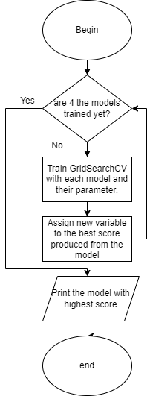
Predictive Analysis (Classification)
4 dissimilar machine learning are implemented in order to produce the best outcome:
K-Nearest-Neighbors
Tree Decision Classifier
Support Vector Machine
Logistic Regression
For each model, a wide of parameter are assessed via GridSearchCV to evaluate the effectiveness of each parameter.
Link for reference:
Module 9

Slide 16
Results
Exploratory data analysis results
Interactive analytics demo in screenshots
Predictive analysis results

Slide 17

Section 2

Slide 18
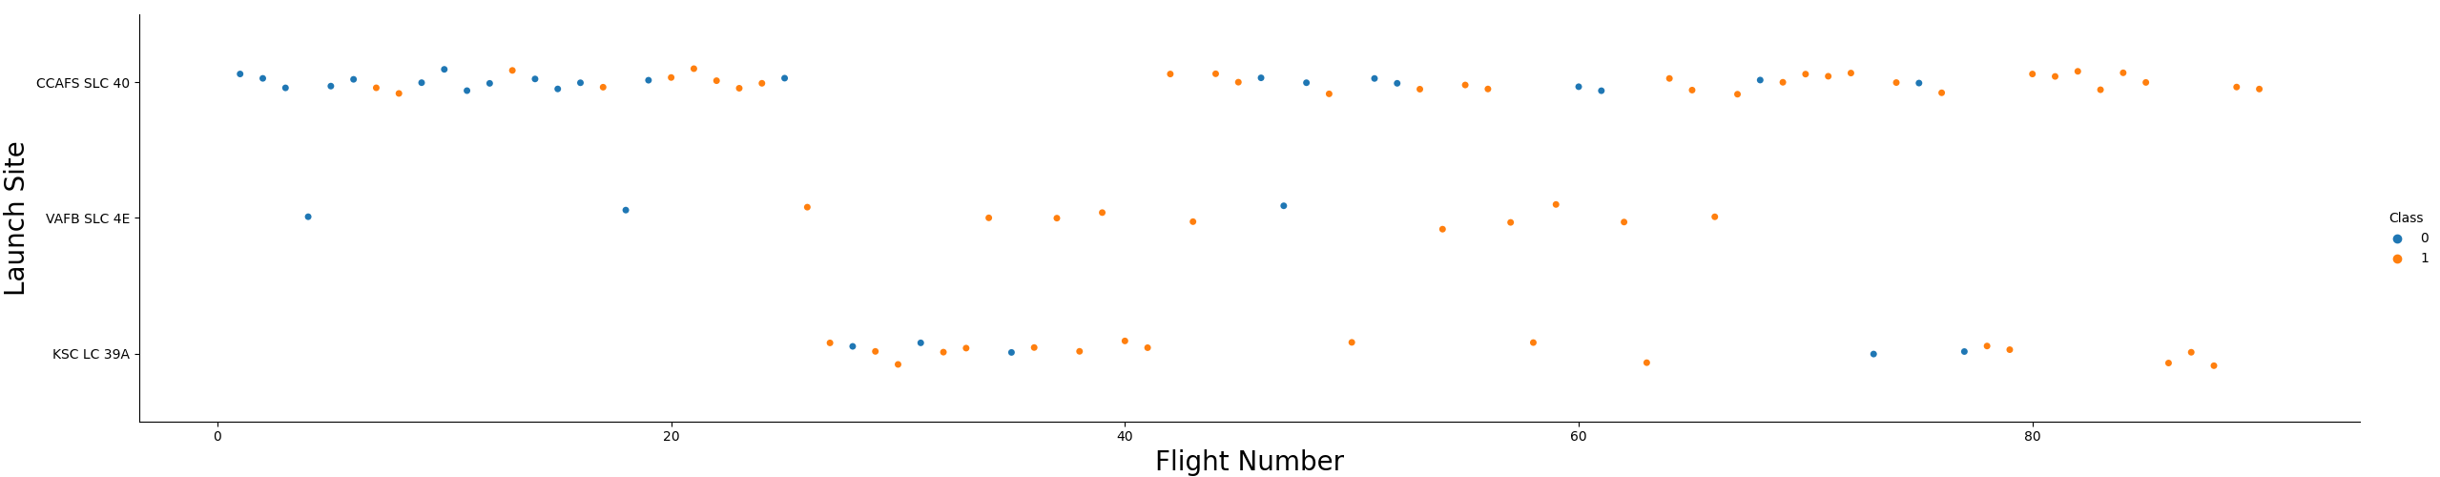
Flight Number vs. Launch Site
KSC LC 39A has a lower rate of failure while
CCAFS SLC 40 has the highest failure percentage.
Thus, this indicates that KSC LC 39A is the best
launch site among the three options

Slide 19
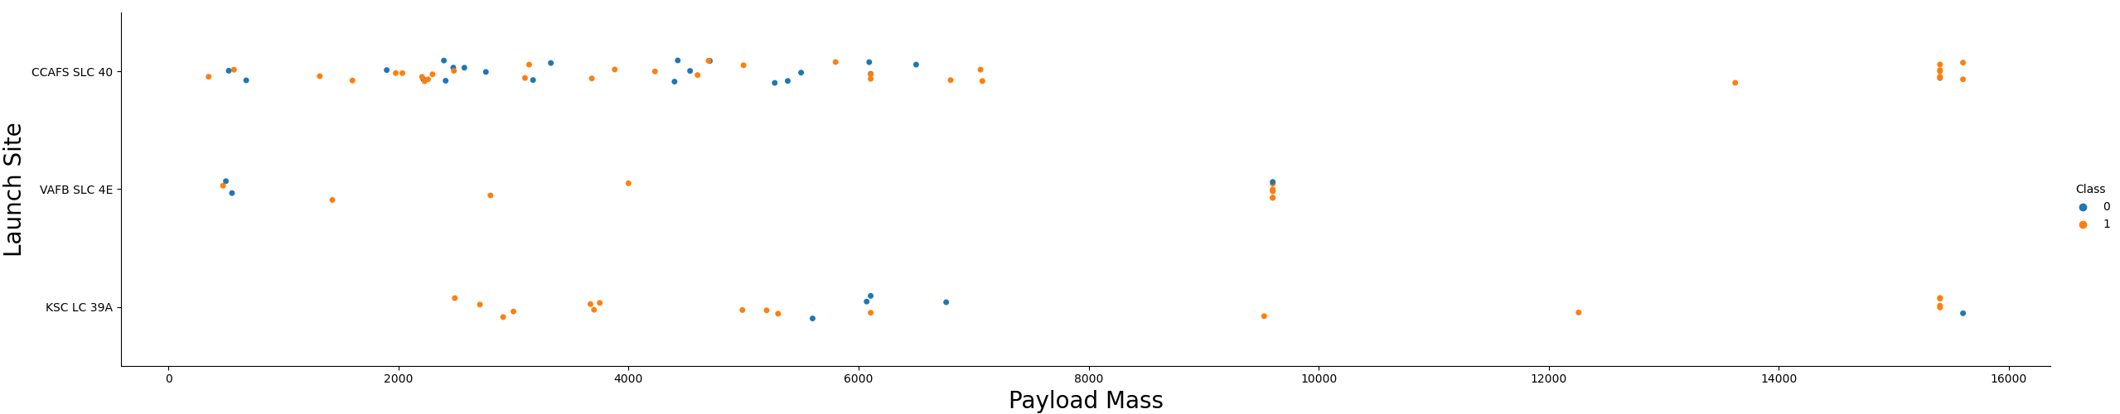
Payload vs. Launch Site
Payload mass exceeding 8000kg have a higher possibility of succeeding.
Now if you observe Payload Vs. Launch Site scatter point chart you will find for the VAFB-SLC launchsite there are no rockets launched for heavypayload mass(greater than 10000).

Slide 20
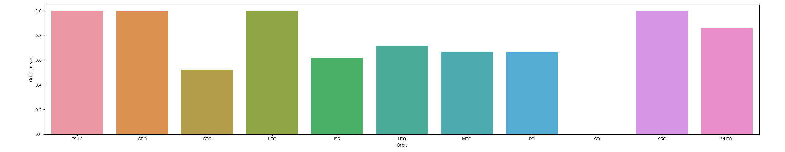
Success Rate vs. Orbit Type
Launching rocket to ES-L1, GEO, HEO and SSO has the highest rate of success.

Slide 21
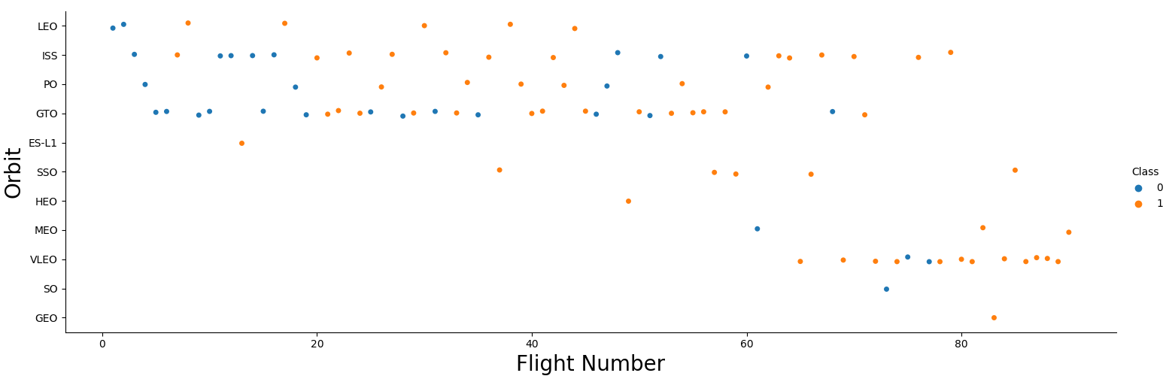
Flight Number vs. Orbit Type
In the LEO orbit the Success appears related to the number of flights; on the other hand, there seems to be no relationship between flight number when in GTO orbit.

Slide 22
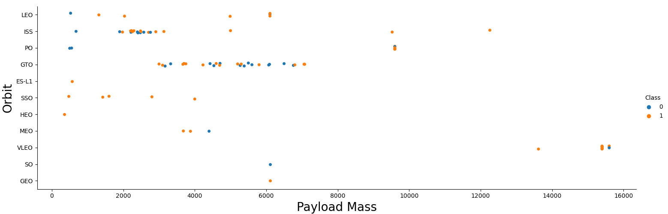
Payload vs. Orbit Type
With heavy payloads the successful landing or positive landing rate are more for Polar,LEO and ISS.
However for GTO we cannot distinguish this well as both positive landing rate and negative landing(unsuccessful mission) are both there here.

Slide 23
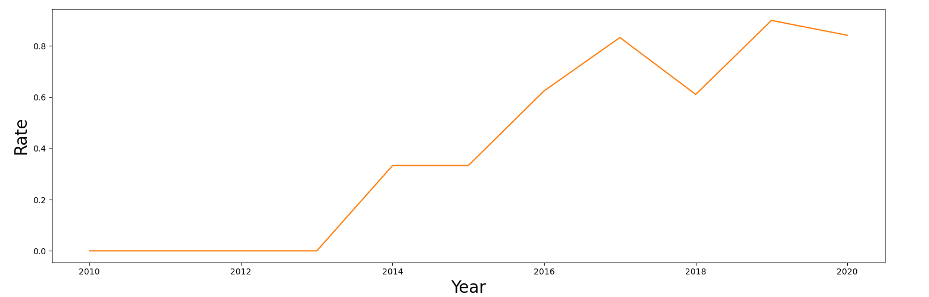
Launch Success Yearly Trend
the sucess rate since 2013 kept increasing till 2020

Slide 24
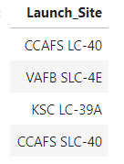
All Launch Site Names

Slide 25
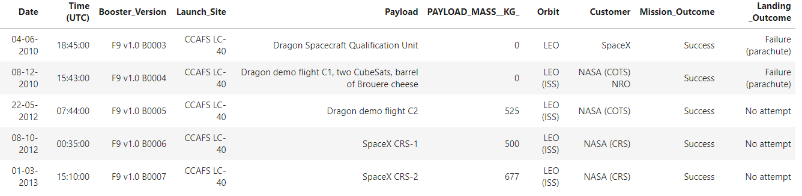
Launch Site Names Begin with 'CCA'
First 5 Record with Launch Site Name Begin with CCA

Slide 26
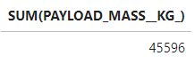
Total Payload Mass
This is the total payload carried by boosters from NASA

Slide 27
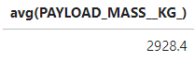
Average Payload Mass by F9 v1.1
The average payload mass carried by booster version F9 v1.1

Slide 28

First Successful Ground Landing Date
The dates of the first successful landing outcome on ground pad

Slide 29
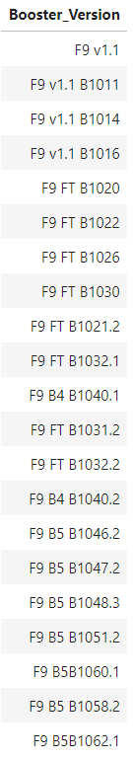
Successful Drone Ship Landing with Payload between 4000 and 6000
The boosters which have successfully landed on drone ship and had payload mass greater than 4000 but less than 6000

Slide 30
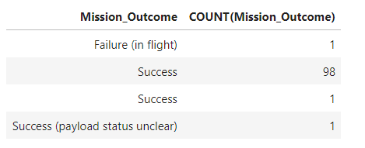
Total Number of Successful and Failure Mission Outcomes
The total number of successful and failure mission outcomes

Slide 31
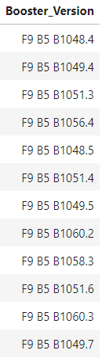
Boosters Carried Maximum Payload
The booster which have carried the maximum payload mass

Slide 32
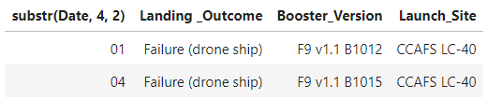
2015 Launch Records
The failed landing_outcomes in drone ship, their booster versions, and launch site names for in year 2015

Slide 33
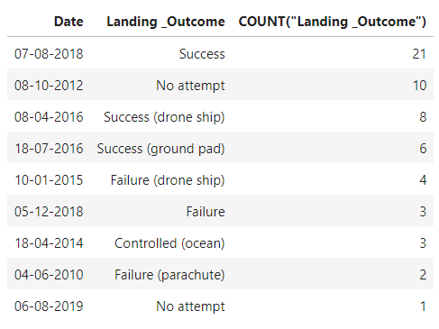
Rank Landing Outcomes Between 2010-06-04 and 2017-03-20
The ranking of count of landing outcomes between the date 2010-06-04 and 2017-03-20, in descending order

Slide 34

Section 3

Slide 35
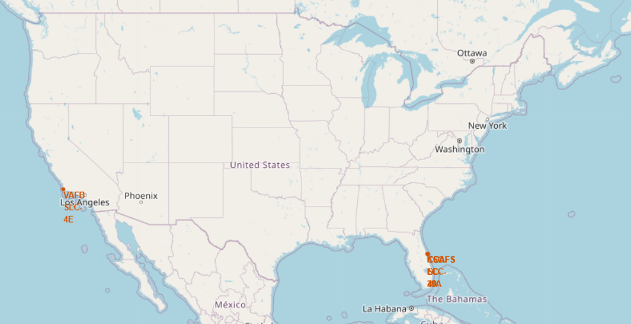
Launch Site Geographical Area
As you may see on the map, the launch sites are marked with red dotes along with their name.
Launch sites are chosen near to the coastline.

Slide 36
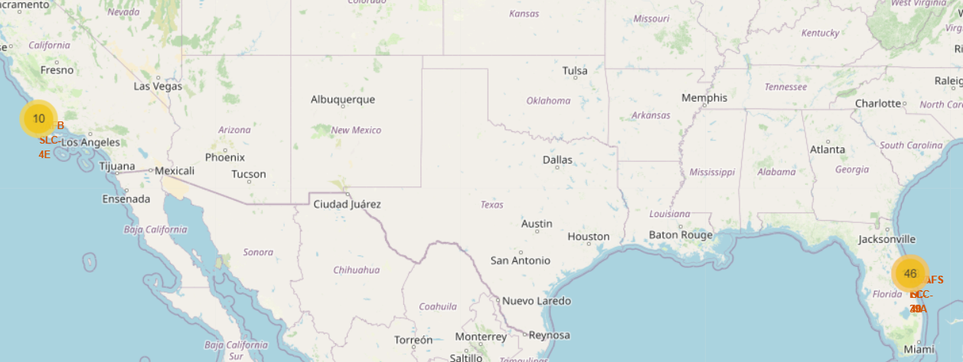
Rocket Launched Clusters
The number in a circle demonstrate the amount of rocket launched in that area.

Slide 37
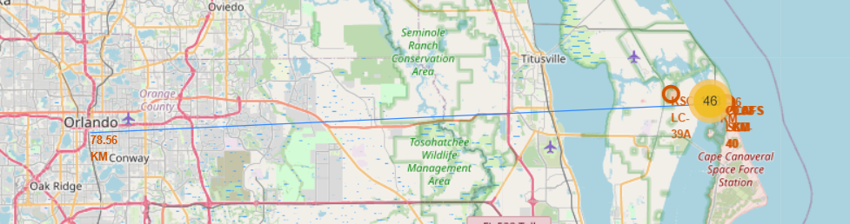
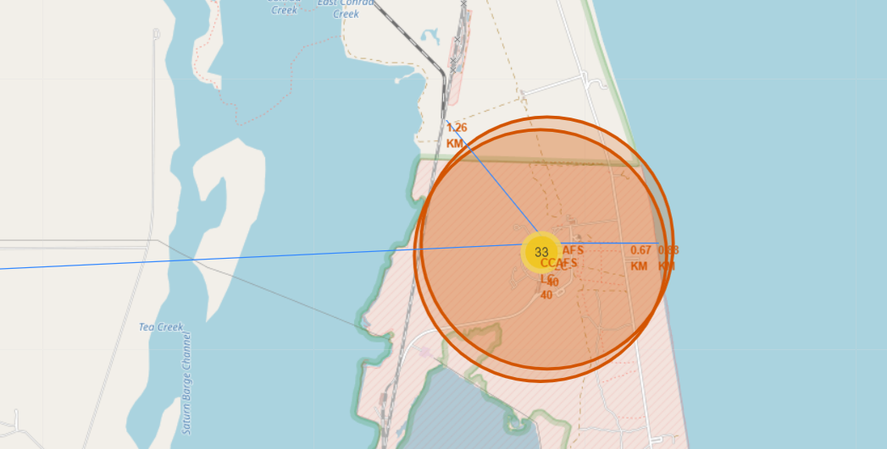
Distance between Launch site and infrastructures
Blue line on the map shows the distance between the launch site and the nearest city, railway and highway respectively.

Slide 38

Section 4

Slide 39
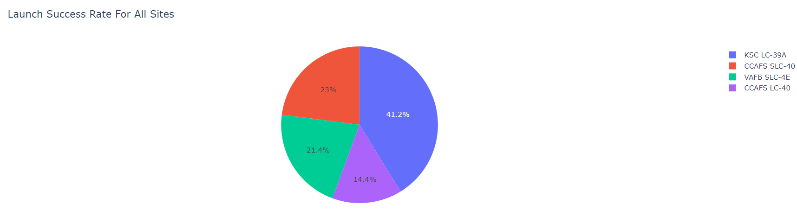
Pie chart for launch success rate of all sites
Pie chart above shown the success rate of each rocket launching sites.
Figure shown KSC LC-39A has the most success launches whereas CCAPS LC-40 has the least.

Slide 40
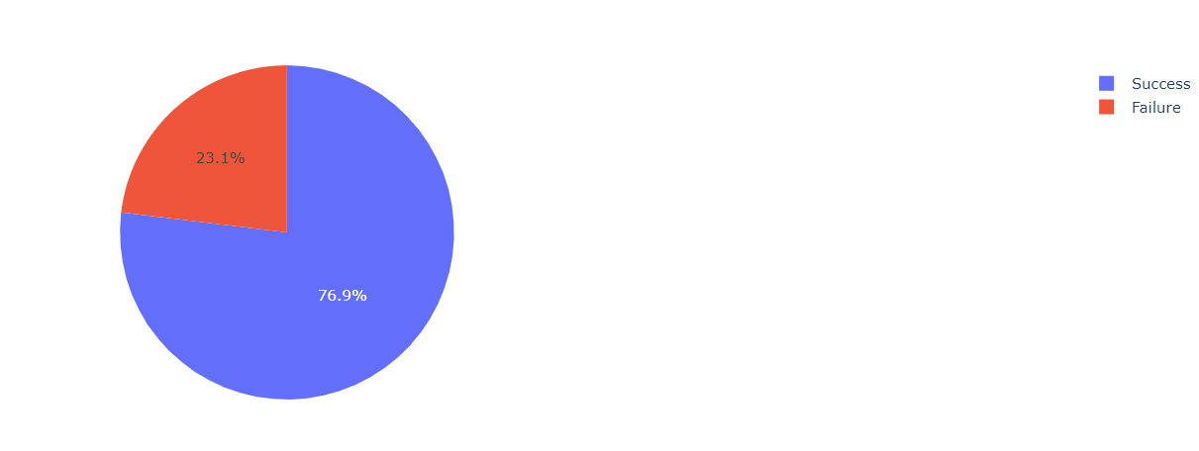
Highest Launching Success Rate
Chart tells that KSC LC-39A has the highest success rate among all of the launch site for which it has a 76.9% chance to succeed.

Slide 41
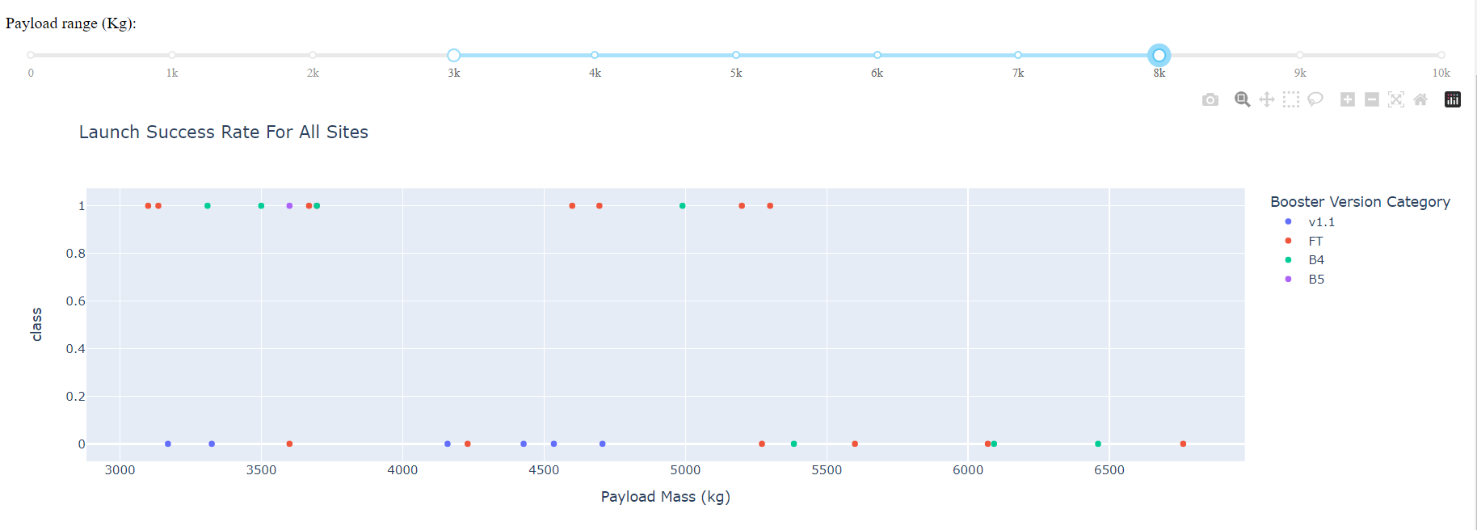
Launch Success Rate with Payload Mass Ranging Between 3000 to 8000
Plot above shows the Launch Success Rate for all site with a payload mass between 3000 to 8000.
Figure shows FT Booster version has the most success case.

Slide 42

Section 5

Slide 43
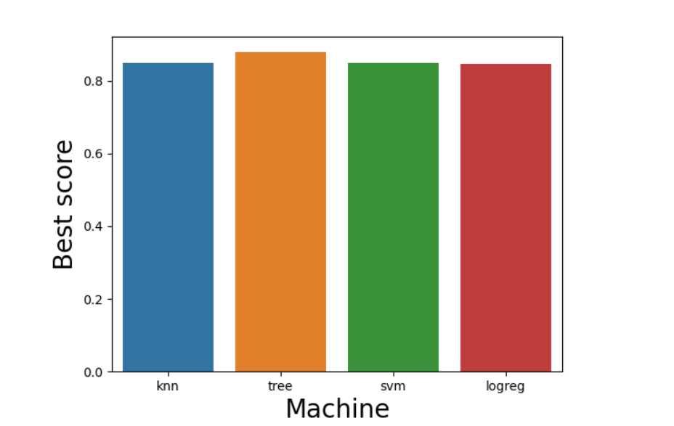
Classification Accuracy
Bar chart above shows Tree Decision Model has the highest best score, 0.9 than the rest

Slide 44
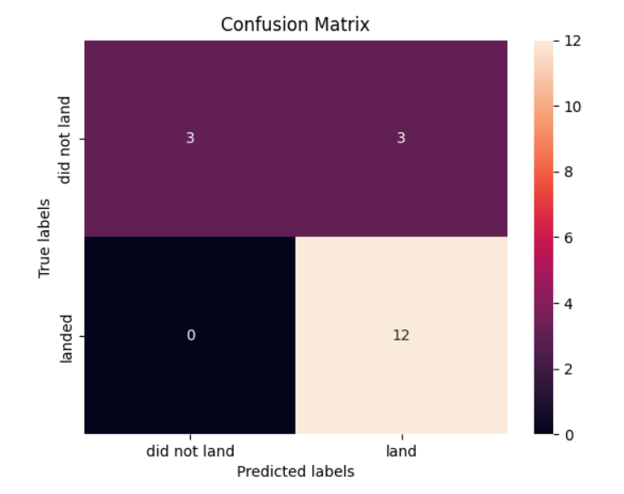
Confusion Matrix
Confusion matrix displayed portrays the major problem of the model which is false positive in which it predicted 3 did not land as land. Meanwhile, it anticipate all the correct output for landed.

Slide 45
Conclusions
With the aim of increasing the possibility of succeed, KSC LC-39A is the best spot for rocket launching at this point.
Furthermore, ES-L1, GEO, HEO and SSO are the recommended orbits to embark the launching of rocket
Moreover, it is affirmative that payload with mass more than 8000kg can land or set off without crashing and hence we shall increase the mass of rocket until it exceeds 8000kg.
Decision Tree Classifier is the best categorical model by far.
All the best for SPACE Y!

Slide 46


